Slide 1

CSE 8A – Introduction to Programming and Computational Problem Solving I
Conditionals + Using VSCode to Understand Code
How to get help:
Class Website
https://sites.google.com/ucsd.edu/cse8afa23/home
Piazza for brief questions or logistic questions
Tutor Hours for help with homework/setting up computer To get help, use Autograder (directions on piazza)
Office Hours for homework/conceptual help
Slides based, in part, on materials from Dan Zingaro.
xkcd.com
Notes:
Welcome!

Slide 2
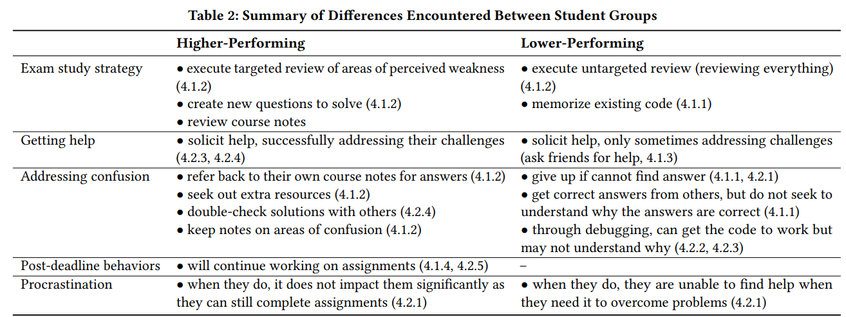
Succeeding in introductory CS!
Liao et al. 2019. Behaviors of Higher and Lower Performing Students in CS1. ITiCSE 2019.
Notes:
Some useful hints from this study
Careful: Correlation and Causation. If a student is already really lost, they aren’t in a position to conduct a targeted review.

Slide 3
Announcements
Homework 2 due next Monday at 10pm
Homework 1 extended to Friday for late enrollments
Discussion tomorrow!
First real quiz is in lab on Wednesday 10/18
Lab 3 will be a take-home lab
Extensions students
Everything should now be set, see piazza for details
Notes:
Mention extension

Slide 4
Learning Goals for Today
By the end of today’s lecture, you should be able to:
Trace and modify code that includes conditional statements and functions

Slide 5
Recall - Boolean Operators
What is printed by the code below? ( not has the highest precedence, then and, then or.)
a = True
b = False
c = True
print(not a and b or c)
A. True
B. False
Notes:
Not True and False or True
False and False or True
False or True
True

Slide 6
Conditionals!
Notes:
Talk about conditionals in everyday life.
If I have a reading for class, I read the book.
When emptying the dishwasher, I make decisions based on conditionals
If a plate, put with plates in the cupboard
elif a glass, put with glasses in the cupboard
elif if a utensil, put with utensils in the drawer
Else … put in dish strainer for someone else to put away

Slide 7
Conditionals: If and If-Else
To do something if a condition is true, and nothing if the condition is false:
if <condition>:
<sequence-of-statements>
To do something if a condition is true, and something else if that condition is false:
if <condition>:
<sequence-of-statements-1>
else:
<sequence-of-statements-2>
The indent is absolutely critical here to say what should execute
Notes:
Draw memory models

Slide 8
Let’s code a couple examples
Notes:
Live coding
Abs
Even/odd

Slide 9
Multi-Way Ifs
if <condition-1>:
<sequence-of-statements-1>
elif <condition-2>:
<sequence-of-statements-2>
elif ...
...
else:
<sequence-of-statements-n>
Think of this whole thing as one big structure
Python evaluates the conditions from top to bottom
When it finds a condition that is true, it executes the corresponding indented statements and continues after this structure
The else is optional
If it’s there, it executes exactly when all conditions above it are false.
Notes:
Draw memory models

Slide 10
Conditionals
if temperature > 32:
print("above freezing")
else:
print("below freezing")
if temperature == 32:
print("at freezing")
Does the code above do exactly the same thing as the code below? (Assume temperature already refers to some numeric value.)
if temperature > 32:
print("below freezing")
elif temperature < 32:
print("below freezing")
elif temperature == 32:
print("at freezing")
A. Yes
B. No
Notes:
B – the temperature of 32 prints two things in the first code

Slide 11
Conditionals Continued
What is the output of the code below?
x = 5
if x < 15:
if x > 8:
print("one")
else:
print("two")
else:
print("three")
A. one
B. two
C. three
D. More than one of the above are output
E. No output
Notes:
two

Slide 12
Short-circuit evaluation
When an expression contains and or or, Python evaluates from left to right
It stops evaluating once the truth value of the expression is known
For x and y, if x is False, there is no reason to evaluate y
For x or y, if x is True, there is no reason to evaluate y
The value of the expression ends up being the last condition actually evaluated by Python
False and True # examples
True and False
0 and 5
1 or 0
0 or 1

Slide 13
Conditionals Continued
In the following expression, which parts are evaluated?
(7 > 2) or ( (9 < 2) and (8 > 3) )
A. Only the first condition
B. Only the second condition
C. Only the third condition
D. The first and third condition
E. All of the code is evaluated
Notes:
Just 7 > 2 The parens bind the “and” operator to 9<2 and 8>3 as operands, but Python still goes left to right. Thankfully, the lack of ++ operators in Python makes it less important to discuss the difference between binding of operators to operands and order of evaluation .

Slide 14
Conditionals Continued
In the following expression, which parts are evaluated?
((7 > 2) and (9 < 2) ) or (8 > 3) )
A. Only the first condition
B. Only the second condition
C. Only the third condition
D. The first and third condition
E. All of the code is evaluated
Notes:
E – all has to be evaluated

Slide 15
Conditionals Continued
age = int(input("What is your age?"))
if age < 18:
print('minor')
elif age >= 18 and age < 30:
print('young adult')
elif age >= 30:
print('adult')
else:
print('ageless’)
What can be removed without changing what the code does?
A. The red code (i.e., age >= 18) can be removed
B. The blue code (i.e., the last two lines) can be removed
C. Both the red and blue code can be removed
D. Nothing can be removed
Notes:
C – elif is redundant and the else can’t execute.

Slide 16
Summary
Python has numeric operators for calculations and string operations for text
We need a clear understanding of these to be able to read code
Conditionals allow us to perform logical tests of relationships of variables and change what the code does based on that relationship

